Slide 1
ABC call volume trend analysis
Manan Yadav
yadavmanan1111@gmail.com

Slide 2
Project description
A customer experience (CX) team consists of professionals who analyze customer feedback and data, and share insights with the rest of the organization. Typically, these teams fulfill various roles and responsibilities such as Customer experience programs (CX programs), Digital customer experience, Design and processes, Internal communications, Voice of the customer (VoC), User experiences, etc.
Advertising is a way of marketing your business in order to increase sales or make your audience aware of your products or services. Until a customer deal with you directly and actually buys your products or services, your advertising may help to form their first impressions of your business. The target audience for businesses could be local, regional, national, or international, or a mixture. So, they use different ways for advertisement. Some of the types of advertisements are Internet/online directories, Trade and technical press, Radio, Cinema, Outdoor advertising, National papers, magazines, and TV.
In this project, analysis is done on a dataset having information on calls for an ABC Company. Data includes Agent_Name, Agent_ID, Queue_Time [duration for which customers have to wait before they get connected to an agent], Time [time at which a call was made by a customer in a day], Time_Bucket [for easiness we have also provided you with the time bucket], Duration [duration for which a customer and executives are on call, Call_Seconds [for simplicity we have also converted those time into seconds], call status (Abandon, answered, transferred).

Slide 3
approach
Downloading the data set and performing EDA to understand the data set. Checked for the null values and the distribution. Defining the problem and analyzing each task first and noted the features to be used.
Now to get the result I checked all the functions which will be required to perform the operations. Create charts and graphs to define underlying aspects of the data. Finally created a report consisting of the description, approach, result, insights, conclusion, etc.

Slide 4
Tech-stack used
Microsoft Excel 2019
Microsoft PowerPoint 2019

Slide 5
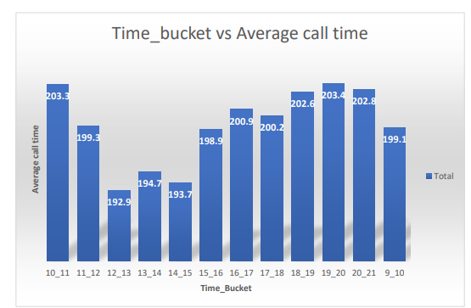
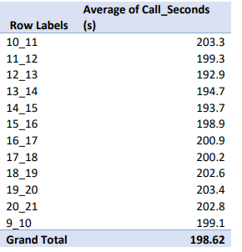
Insights
The first task was to calculate the average call time duration for all incoming calls received by agents (in each Time_Bucket).
Minimum average call time is for time bucket 12_13.
Total average time to answer each call is 198.62 sec.

Slide 6
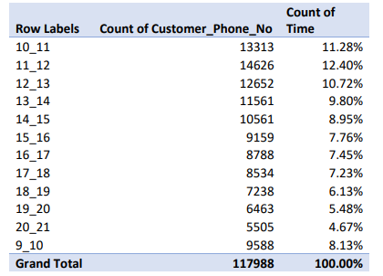
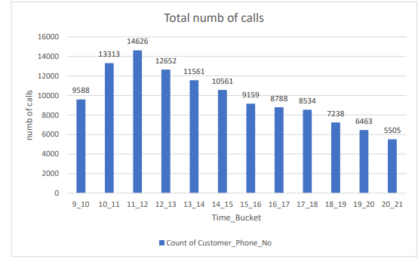
Insights
The Second task was to show the total volume/ number of calls coming in via charts/ graphs [Number of calls v/s Time]. You can select a time in a bucket form (i.e., 1-2, 2-3, ….)

Slide 7
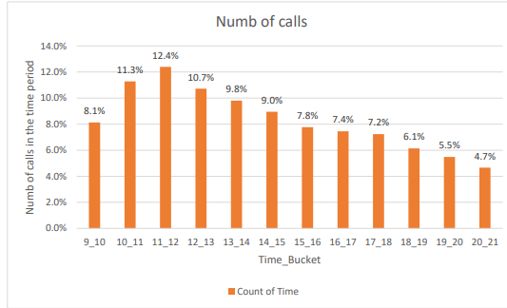

Slide 8
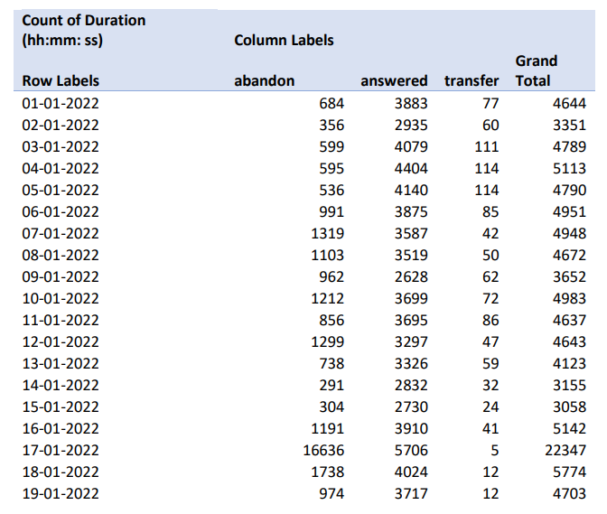
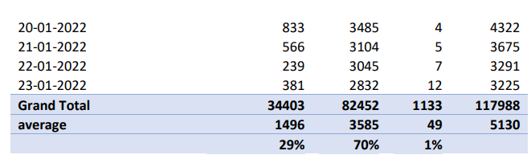
Insights
In the third was : As you can see current abandon rate is approximately 30%. Propose a manpower plan required during each time bucket [between 9 am to 9 pm] to reduce the abandon rate to 10%. (i.e., You have to calculate a minimum number of agents required in each time bucket so that at least 90 calls should be answered out of 100.)

Slide 9
Insights
In the pivot table Date & Time is dragged down to Rows, call_status to the column while taking count of call_duration in the values section.
Then, we calculated the average of abandon, answered, and transfer by using the average formula in Excel.
29% of the calls are abandoned, 1% are transferred, and 70% of the calls are answered in the daytime.
Total agents working can be calculated by average calls on a single day divided by the total time spent by one man in a single day.
total agents = 187.96/5 = 37.59
If agents are working for 5 hrs. a day and 60% of calls are getting answered. If we want 90% of the calls to get connected, we apply a unitary method to find how many more employees we want.
total agent = 90*37.59/60 = 57 agents.

Slide 10
Insights
The next was to find: Let’s say customers also call this ABC insurance company at night but didn’t get an answer as there are no agents to answer, this creates a bad customer experience for this Insurance company. Suppose for every 100 calls that the customer made from 9 Am to 9 Pm, the customer also made 30 calls in the night between interval [9 Pm to 9 Am], and the distribution of those 30 calls are as follows:
Here we have taken an assumption: An agent work for 6 days a week; On average total unplanned leaves per agent is 4 days a month; An agent’s total working hrs. is 9 hrs. out of which 1.5 hrs. go into lunch and snacks in the office. On average an agent occupied for 60% of his total actual working hrs. (i.e. 60% of 7.5 hrs.) on a call with customers/ users. The total number of days in a month is 30 days.

Slide 11
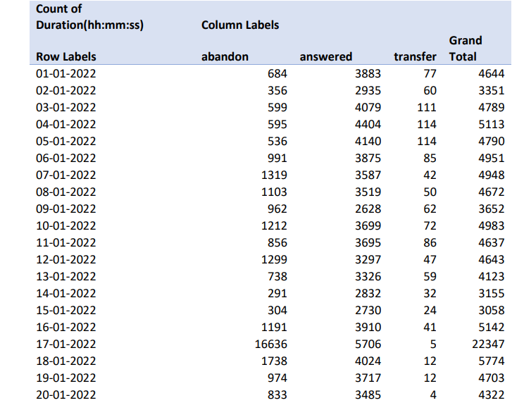
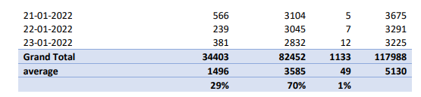
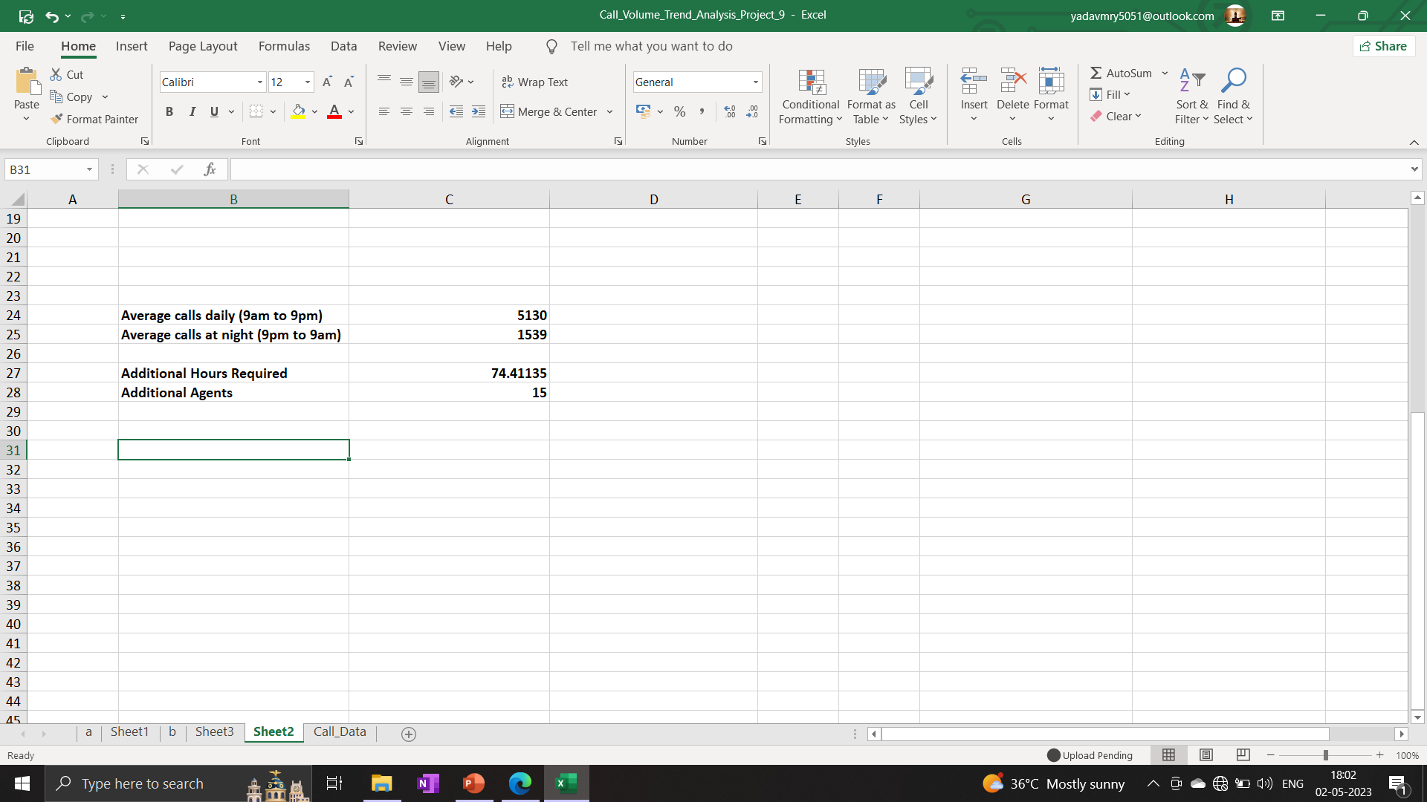
Insights

Slide 12
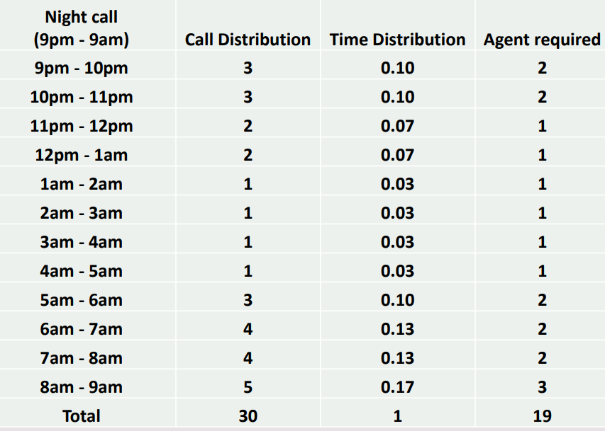
Insights
The customers call the least in the evening. So, the company can reduce the number of agents at that time for answering the calls.
The company can hire 15 customer support agents for the night shift work. The company can shift some of the day workers for the night shift.
The employees who are working 9 am to 9 pm. The manager can change some of the workers shift from 5 am to 2 pm and some workers from 2 pm to 11 pm to get the most calls answered.
The company can make the employers divide into 3 parts too, so that the agents are always available 24/7

Slide 13
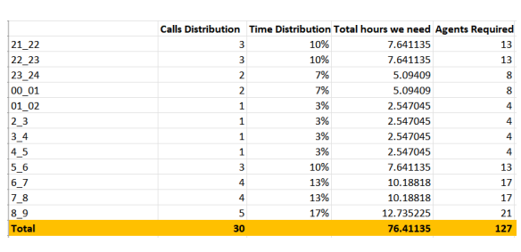
Insights

Slide 14
Results
In this project I came to know how an analyst can make an impact on the customer service department and how the company deals with the customers to give the satisfaction reply.
After completion of this project, my experience in using pivot tables and the formulas used in Excel has also increased.
I got to know about the IVR Duration, which is an AI tool, that answers calls to get to know the customer’s exact question and then transfers it to the right agent to get the customer’s queries get answered.

